Slide 1
Chapter 2: Relational Model

Slide 2
Contents
Structure of Relational Databases
Fundamental Relational-Algebra-Operations
Additional Relational-Algebra-Operations
Extended Relational-Algebra-Operations
Null Values
Modification of the Database
Chapter2 Relational Model

Slide 3
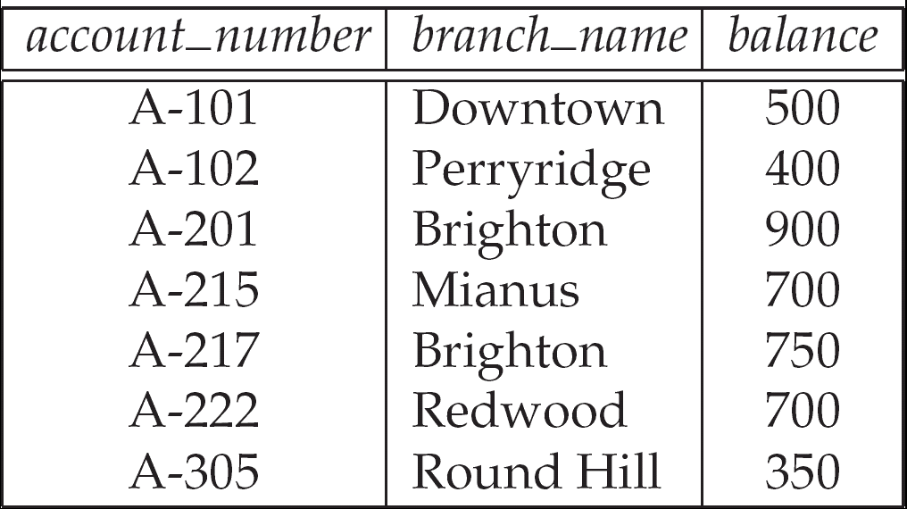


Structure of Relational Database
On the logical level, relational database is a collection of 2-D tables called Relations
relations represents
an entity set or
a relationship set
A row of a relation
represents a entity
or a relationship
Chapter2 Relational Model

Slide 4
Basic Structure
Each row of a relation can be referred to as tuple
Each column of a relation has a name ➔ named columns of a relation are referred to as attributes
The set of allowed values for each attribute is called the domain of the attribute
Chapter2 Relational Model

Slide 5
Basic structure
Cont.
Attribute values are (normally) required to be atomic; that is, indivisible
  the value of a tuple on an attribute can be
  an account number, but cannot be a set of account numbers
The special value null is a member of every domain
Chapter2 Relational Model

Slide 6
Example
Has 3 attributes ➔ customer_name, customer_street, customer_city
D1: The set of all possible customer names
D2: The set of all possible customer streets
D3: The set of all possible customer city
Relation customer is a subset of:
D1 ×D2×D3
Relation Customer
Tuple
Chapter2 Relational Model

Slide 7
Relation
Cartesian Product
Formally, given sets D₁, D₂, …. D_{n} a relation r is a subset of
D₁ x D₂ x … x D_{n}
Thus, a relation is a set of n-tuples (a₁, a₂, …, a_{n}) where each a_{i} ∈ D_{i}
Chapter2 Relational Model

Slide 8
Example
  customer_name = {Jones, Smith, Curry, Lindsay, …}
  customer_street = {Main, North, Park, …}
  customer_city = {Harrison, Rye, Pittsfield, …}
  Then relation r
  customer_name customer_street customer_city
  Jones Main Harrison
  Smith North Rye
  Curry North Rye
  Lindsay Park Pittsfield
  is a relation over
customer_name x customer_street x customer_city
Chapter2 Relational Model

Slide 9
Tuple Variable
Tuple variable
  is a variable that stands for a tuple
  Whose domain is the set of all tuples of a particular relation
Example
t is a variable refer to a tuple in Account
t[Account_number]=
A-305
A-102
t[branch_name]=
Perryridge
Round Hill
t[balance]=
350
400
Chapter2 Relational Model

Slide 10
Relation Schema
A₁, A₂, …, A_{n} are attribute names
R = (A₁, A₂, …, A_{n} ) is a relation schema
    customer_schema = (customer_name, customer_street, customer_city)
r(R) denotes a relation r on the relation schema R
    customer (customer_schema)
The current values (relation instance) of a relation are specified by a table
Chapter2 Relational Model

Slide 11
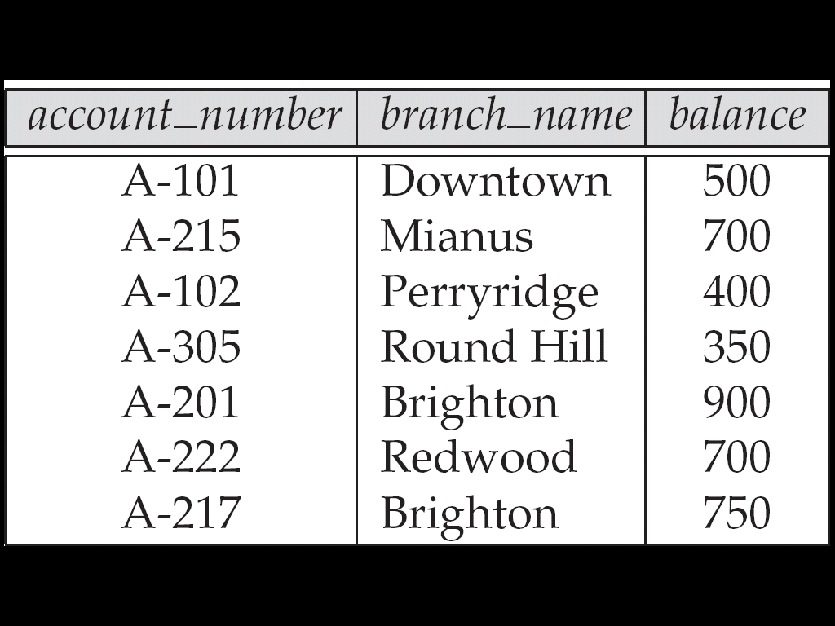
Relations are Unordered
Order of tuples is irrelevant (tuples may be stored in an arbitrary order)
Example
account relation with unordered tuples
Chapter2 Relational Model
Notes:
元组的顺序不相关（元组可以任意顺序存储）

Slide 12
Relational Database
A database consists of multiple relations
Information about an enterprise is broken up into parts, with each relation storing one part of the information
Example
account : stores information about accounts
depositor : stores information about which customer owns which account
customer : stores information about customers
Chapter2 Relational Model
Notes:
数据库由多个关系组成
关于一个企业的信息被分解成由多个关系组成的PAA数据库
有关企业的信息被分成若干部分，每个关系存储一部分信息
RTS，每个关系存储一部分信息

Slide 13
Relational Database
Cont.
Storing all information as a single relation
  repetition of information
  the need for null values
Normalization theory (Chapter 7) deals with how to design relational schemas
bank(account_number, balance, customer_name, ....)
Result in
if two customers own an account (What gets repeated?)
to represent a customer without an account
Chapter2 Relational Model

Slide 14
The Account Relation
Chapter2 Relational Model

Slide 15
The customer Relation
Chapter2 Relational Model

Slide 16
The depositor Relation
Chapter2 Relational Model

Slide 17
Keys
K is a set of attributes, let K ⊆ R
K is a superkey of R if values for K are sufficient to identify a unique tuple of each possible relation r(R)
  by “possible r ” we mean a relation r that could exist in the enterprise we are modeling.
Chapter2 Relational Model
Notes:
k是一组属性，设k r
如果k的值足以识别每个可能关系r（r）的唯一元组，k是r的超键。
“可能的R”是指我们正在建模的企业中可能存在的关系R。

Slide 18
Example
If no two customers can possibly have the same name，{customer_name, customer_street} and {customer_name} are both superkeys of customer
Chapter2 Relational Model

Slide 19
Keys
Cont.
Superkey K is a candidate key if K is minimal
  Minimal means no subset of it is superkey
Example
{customer_name} is a candidate key for customer, since it is a superkey and no subset of it is a superkey.
Chapter2 Relational Model
Notes:
如果k最小，则superkey k是候选键
最小意味着它的任何子集都不是超键

Slide 20
Keys
Cont.
Primary key: a candidate key chosen as the principal means of identifying tuples within a relation
  Should choose an attribute whose value never, or very rarely, changes.
Example
email address is unique, but may change,
is not suitable for primary key
Chapter2 Relational Model
Notes:
主键：被选为标识关系中元组的主要方法的候选键。
应该选择一个值从不改变或很少改变的属性。

Slide 21
Foreign Keys
A relation r1 may have an attribute that corresponds to the primary key of another relation r2. The attribute is called a foreign key
  r1 is referencing relation
  r2 is referenced relation
Example
customer_name and account_number attributes of depositor are foreign keys to customer and account respectively. depositor is referencing relation, customer and account are referenced relation
Chapter2 Relational Model
Notes:
关系R1可以具有对应于另一关系R2的主键的属性。该属性称为外键
R1是引用关系
r2为参考关系

Slide 22

Example
Referenced relation
Referenced relation
Primary Key
Foreign Key, Corresponds to the primary key of relation Account
Foreign Key, Corresponds to the primary key of relation Customer
Referencing relation
Chapter2 Relational Model
Notes:
外键，对应关系帐户的主键

Slide 23
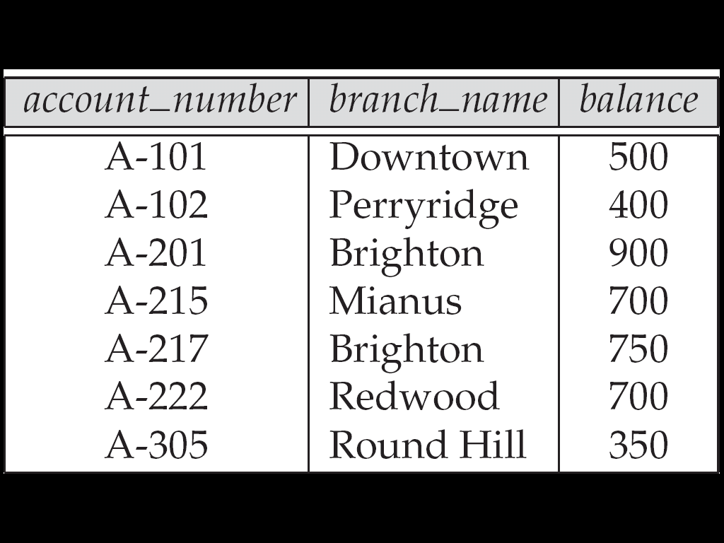
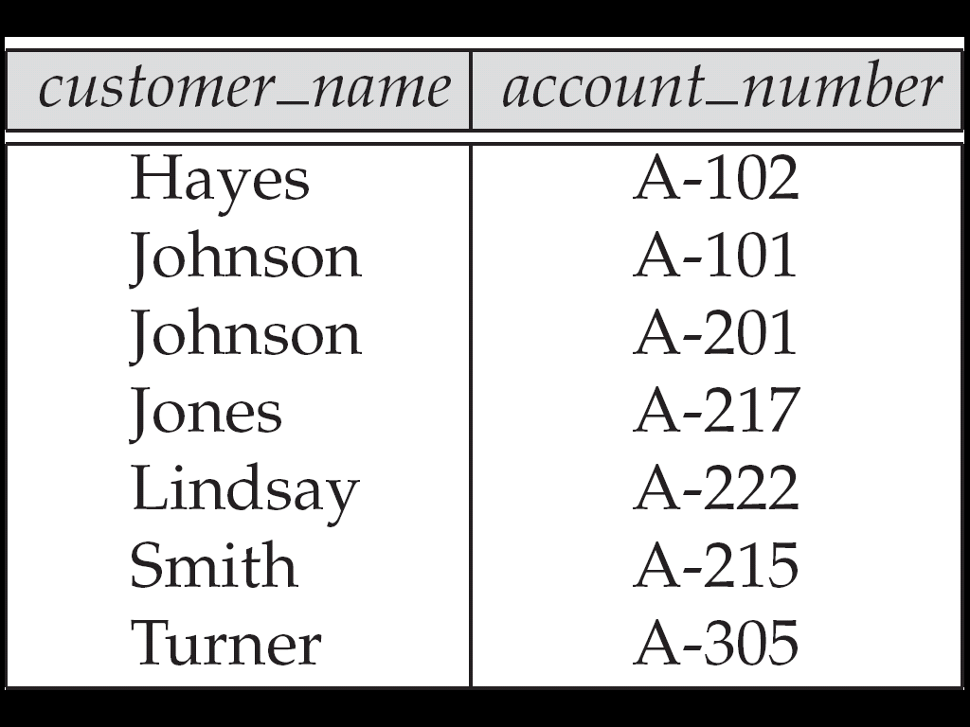
Referencing Constraint
Only values occurring in the primary key attribute of the referenced relation may occur in the foreign key attribute of the referencing relation
Is subset of…
Chapter2 Relational Model
Notes:
只有引用关系的主键属性中出现的值才能出现在被引用关系的外键属性中。

Slide 24
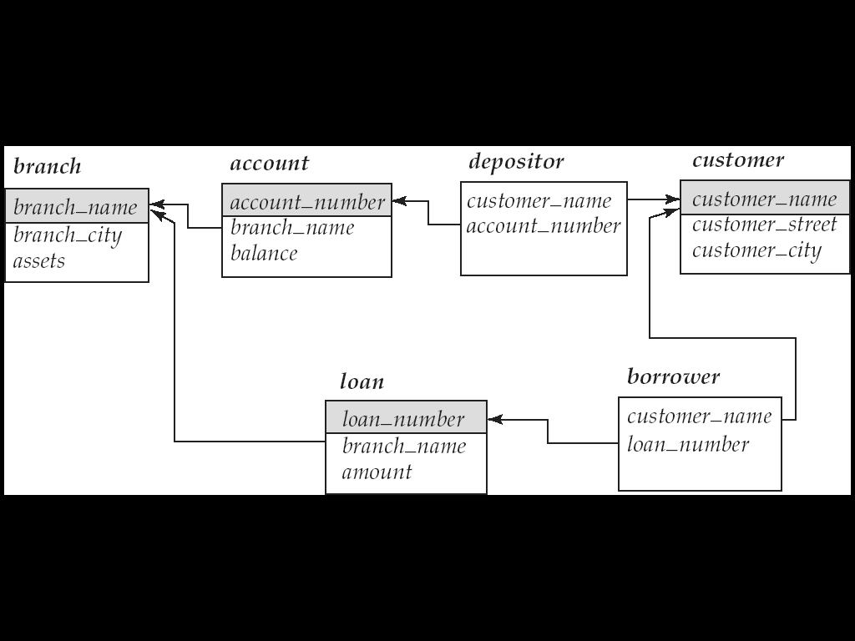
Schema Diagram
Chapter2 Relational Model

Slide 25
Query Languages
Language in which user requests information from the database.
Categories of languages
  Procedural
  Non-procedural, or declarative
“Pure” languages:
  Relational algebra
  Tuple relational calculus
  Domain relational calculus
form underlying basis of query languages that people use
Procedural
Nonprocedural
Chapter2 Relational Model
Notes:
用户从数据库请求信息的语言。
语言类别
程序性
非程序性或声明性
“纯”语言：
关系代数
元组关系演算
域关系演算

Slide 26
Relational Algebra
Consists of a set of operators take one or two relations as inputs and produce a new relation as a result
Six basic operators
  select: σ
  project: ∏
  union: ∪
  set difference: –
  cartesian product: x
  rename: ρ
Chapter2 Relational Model

Slide 27
Select Operation
Select tuples that satisfy a given prodicate
Example
Relation r
σ_{A=B ^ D > 5} (r)
A
B
C
D
A
B
C
D
α
α
β
β
α
β
β
β
1
5
12
23
7
7
3
10
α
β
α
β
1
23
7
10
Chapter2 Relational Model

Slide 28
Select Operation
Cont.
Notation: σ _{p}(r)
Defined as:
selection predicate
σ_{p}(r) = {t | t ∈ r and p(t)}
Where p is a formula in propositional calculus consisting of terms connected by : ∧ (and), ∨ (or), ¬ (not)，Each term is one of:
<attribute> op <attribute> or <constant>
where op is one of: =, ≠, >, ≥. <. ≤
Chapter2 Relational Model

Slide 29
Example
Find the basic information of all students who’s age is bellow 20
σ _{Sage < 20} (Student) σ _{4 < 20} (Student)
Sno
Sname
Ssex
Sage
Sdept
95001
李勇
男
20
CS
95002
刘晨
女
19
IS
95003
王敏
女
18
MA
95004
张立
男
19
IS
95002
刘晨
女
19
IS
95003
王敏
女
18
MA
95004
张立
男
19
IS
Chapter2 Relational Model

Slide 30
Project Operation
A Unary operation, picking certain columns
Example
Relation r
∏_{A,C} (r)
A
B
C
A
C
A
C
α
α
β
β
10
20
30
40
1
1
1
2
α
α
β
β
1
1
1
2
α
β
β
1
1
2
Chapter2 Relational Model

Slide 31
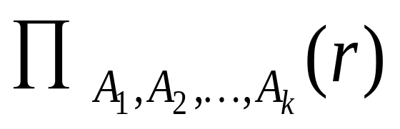
Project Operation
Cont.
Notation:
The result is defined as the relation of k columns obtained by erasing the columns that are not listed
Duplicate rows removed from result, since relations are sets
attribute names
Chapter2 Relational Model
Notes:
符号：
结果定义为通过删除未列出的列而获得的k列的关系。
从结果中删除了重复的行，因为关系是集合

Slide 32
Example
Find the names and the departments of all students
  ∏_{Sname,Sdept}(Student) or ∏ _{2,5}(Student)
Sno
Sname
Ssex
Sage
Sdept
Sname
Sdept
95001
李勇
男
20
CS
李勇
CS
95002
刘晨
女
19
IS
刘晨
IS
95003
95004
王敏
女
18
MA
王敏
MA
张立
男
19
IS
张立
IS
Chapter2 Relational Model

Slide 33
Union Operation
Analogous to set union operation
Example
r
s
r ∪ s
A
B
A
B
A
B
α
α
β
1
2
1
α
β
2
3
α
α
β
β
1
2
1
3
Chapter2 Relational Model

Slide 34
Union Operation
Notation: r ∪ s
Defined as:
r ∪ s = {t | t ∈ r or t ∈ s}
For r ∪ s to be valid.
1. r, s must have the same arity (same number of attributes)
2. The attribute domains must be compatible
2nd column of r deals with the same type of values as does the 2nd column of s
Chapter2 Relational Model
Notes:
符号：R S
定义为：
R S=T T R或T S
R S有效。
1.r，s必须具有相同的arity（相同数量的属性）
2.第二步。属性域必须兼容

Slide 35
Set Difference Operation
Analogous to set difference operation
Example
r
s
r – s
A
B
A
B
A
B
α
α
β
1
2
1
α
β
2
3
α
β
1
1
Chapter2 Relational Model

Slide 36
Set Difference Operation
Notation r – s
Defined as:
Set differences must be taken between compatible relations.
  r and s must have the same arity
  attribute domains of r and s must be compatible
r – s = {t | t ∈ r and t∉s }
Chapter2 Relational Model

Slide 37
Cartesian-Product Operation
Pair each tuple of one relation with each tuple of another
r x s
Example
s
A
B
C
D
E
r
C
D
E
α
α
α
α
β
β
β
β
1
1
1
1
2
2
2
2
α
β
β
γ
α
β
β
γ
10
10
20
10
10
10
20
10
a
a
b
b
a
a
b
b
A
B
α
β
β
γ
10
10
20
10
a
a
b
b
α
β
1
2
Chapter2 Relational Model

Slide 38
Cartesian-Product Operation
Notation r x s
Defined as:
Assume that attributes of r(R) and s(S) are disjoint. (That is, R ∩ S = ∅).
If attributes of r(R) and s(S) are not disjoint, then renaming must be used
r x s = {t q | t ∈ r and q ∈ s}
Chapter2 Relational Model

Slide 39
Composition of Operations***
Can build expressions using multiple operations
Example
A
B
C
D
E
σ_{A=C}(r x s)
α
α
α
α
β
β
β
β
1
1
1
1
2
2
2
2
α
β
β
γ
α
β
β
γ
10
10
20
10
10
10
20
10
a
a
b
b
a
a
b
b
A
B
C
D
E
r x s
α
β
β
1
2
2
α
β
β
10
10
20
a
a
b
Chapter2 Relational Model

Slide 40
Example
Find the names of all customers who have an account at the bank, along with the account number and the balance
∏customer_name, account.account_number, balance
(
σ account.account_number=customer.accoont_number
account × customer
(
)
)
Chapter2 Relational Model

Slide 41
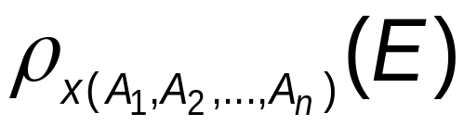
Rename Operation
Allows us to name, and therefore to refer to, the results of relational-algebra expressions
Allows us to refer to a relation by more than one name
ρ _{x} (E)
returns the expression E under the name X
returns the result of expression E under the name X, and with the attributes renamed to A1 , A2 , …., An
Chapter2 Relational Model
Notes:
允许我们命名并因此引用关系代数表达式的结果
允许我们用多个名称引用关系

Slide 42
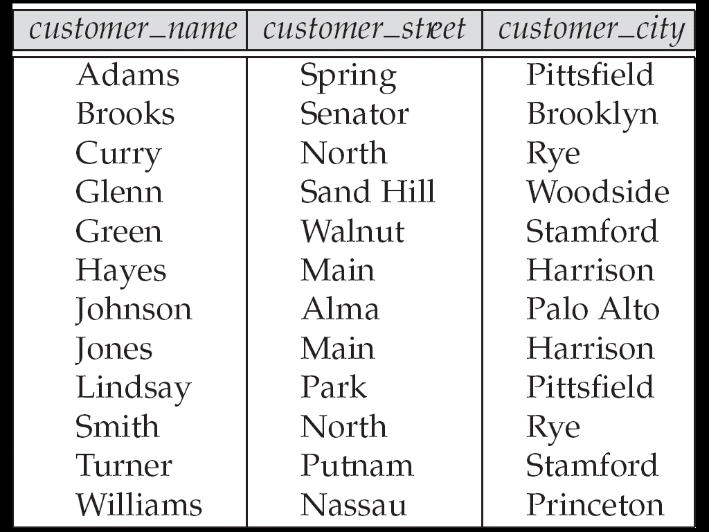
Example
Find the names of all customers who live in the same city as smith
∏_{customer.customer_name}
(
σ _{customer.customer_city =}
_{smith_info.customer_city}
_{?.cutomer._city}
(
customer×
(customer×ρ _{smith_infor}
σ _{customer_name=“smith”} (customer)
)
)
(
)
Chapter2 Relational Model

Slide 43
Banking Example
branch (branch_name, branch_city, assets)
customer (customer_name, customer_street, customer_city)
account (account_number, branch_name, balance)
loan (loan_number, branch_name, amount)
depositor (customer_name, account_number)
borrower (customer_name, loan_number)
Chapter2 Relational Model

Slide 44
Example Queries
Find all loans of over $1200
Find the loan number for each loan of an amount greater than $1200
Find the names of all customers who have a loan, an account, or both, from the bank
σ_{amount > 1200} (loan)
∏_{loan_number} (σ_{amount} _{> 1200} (loan))
  ∏_{customer_name} (borrower)
  ∪ ∏_{customer_name} (depositor)
Chapter2 Relational Model

Slide 45
Example Queries
Cont.
Find the names of all customers who have a loan at the Perryridge branch
Find the names of all customers who have a loan at the Perryridge branch but do not have an account at any branch of the bank
∏_{customer_name} (σ_{branch_name=“Perryridge”}
(σborrower.loan_number = loan.loan_number(borrower x loan)))
∏_{customer_name} (σ_{branch_name = “Perryridge”}
(σborrower.loan_number = loan.loan_number(borrower x loan))) – ∏_{customer_name}(depositor)
Chapter2 Relational Model

Slide 46
Example Queries
Cont.
Find the names of all customers who have a loan at the Perryridge branch
Query 1
∏_{customer_name} (σ_{branch_name = “Perryridge”} (
σborrower.loan_number = loan.loan_number (borrower x loan)))
Query 2
∏_{customer_name}(σloan.loan_number = borrower.loan_number ((σ_{branch_name = “Perryridge”} (loan)) x borrower))
Chapter2 Relational Model

Slide 47
Example Queries
Cont.
Find the largest account balance
  Strategy:
    Find those balances that are not the largest
      Rename account relation as d so that we can compare each account balance with all others
    Use set difference to find those account balances that were not found in the earlier step.
  The query is:
∏_{balance}(account) - ∏_{account.balance}
(σ_{account.balance < d.balance} (account x ρ_{d} (account)))
Chapter2 Relational Model

Slide 48
Additional Operations
We define additional operations that do not add any power to the relational algebra, but that simplify common queries
Set intersection ∩
Natural join
Division ÷
Assignment ←
Chapter2 Relational Model

Slide 49
Set-Intersection Operation
Notation: r ∩ s
Defined as:
Assume:
  r, s have the same arity
  attributes of r and s are compatible
Note: r ∩ s = r – (r – s)
r ∩ s = { t | t ∈ r and t ∈ s }
Chapter2 Relational Model

Slide 50
Example
r
s
r ∩ s
A B
A B
A B
α
α
β
1
2
1
α
β
2
3
α
2
Chapter2 Relational Model

Slide 51
Natural-Join Operation
Notation: r s
Let r and s be relations on schemas R and S respectively.
Then, r s is a relation on schema R ∪ S obtained as follows:
  Consider each pair of tuples t_{r} from r and t_{s} from s.
  If t_{r} and t_{s} have the same value on each of the attributes in R ∩ S, add a tuple t to the result
Chapter2 Relational Model

Slide 52
Example
Natual-Join connects two relations by:
Equating attributes of the same name
And Projecting out one copy of each pair of equated attributes.
r
A
B
C
D
α
β
γ
α
δ
1
2
4
1
2
α
γ
β
γ
β
a
a
b
a
b
r s
A
B
C
D
E
α
α
α
α
δ
1
1
1
1
2
α
α
γ
γ
β
a
a
a
a
b
α
γ
α
γ
δ
B
D
E
s
1
3
1
2
3
a
a
a
b
b
α
β
γ
δ
∈
Chapter2 Relational Model

Slide 53
Division Operation
r ÷ s
Notation:
Let r and s be relations on schemas R and S respectively, where R = (A₁, …, A_{m} , B₁, …, B_{n} ) S = (B₁, …, B_{n})
The result of r ÷ s is a relation on schema
  R – S = (A₁, …, A_{m})
  r ÷ s = { t | t ∈ ∏ _{R-S} (r) ∧ ∀ u ∈ s ( tu ∈ r ) }
  Where tu means the concatenation of tuples t and u to produce a single tuple
Chapter2 Relational Model

Slide 54
Example
r
A
B
α
α
α
β
γ
δ
δ
δ
∈
∈
β
1
2
3
1
1
1
3
4
6
1
2
s
r ÷ s
B
A
1
2
α
β
Chapter2 Relational Model

Slide 55
Example
r
A
B
C
D
E
s
r ÷ s
α
α
α
β
β
γ
γ
γ
a
a
a
a
a
a
a
a
α
γ
γ
γ
γ
γ
γ
β
a
a
b
a
b
a
b
b
1
1
1
1
3
1
1
1
D
E
A
B
C
a
b
1
1
α
γ
a
a
γ
γ
Chapter2 Relational Model

Slide 56
Division Operation*****
Cont.
Definition in terms of the basic algebra operation
Let r(R) and s(S) be relations, and let S ⊆ R
r ÷ s =
∏_{R-S} (r ) – ∏_{R-S} ( ( ∏_{R-S} (r ) x s ) – ∏_{R-S,S}(r ))
To see why
  ∏_{R-S,S} (r) simply reorders attributes of r
  ∏_{R-S} (∏_{R-S} (r ) x s ) – ∏_{R-S,S}(r) ) gives those tuples t in
  ∏_{R-S} (r ) such that for some tuple u ∈ s, tu ∉ r
Chapter2 Relational Model

Slide 57
Assignment Operation
The assignment operation (←) provides a convenient way to express complex queries.
  Write query as a sequential program consisting of
    a series of assignments
    followed by an expression whose value is displayed as a result of the query.
  Assignment must always be made to a temporary relation variable.
Chapter2 Relational Model
Notes:
分配操作（「转易」）提供了一种方便的方式来表达复杂的查询。
将查询作为由
一系列作业
后跟一个表达式，其值作为查询结果显示。
必须始终对临时关系变量进行赋值。

Slide 58
Assignment Operation
Cont.
Example
Write r ÷ s as
temp1 ← ∏_{R-S} (r )
temp2 ← ∏_{R-S} ((temp1 x s ) – ∏_{R-S,S} (r ))
result = temp1 – temp2
  The result to the right of the ← is assigned to the relation variable on the left of the ←.
  May use variable in subsequent expressions
Chapter2 Relational Model

Slide 59
Example Queries
Find the names of all customers who have a loan and an account at bank
  ∏_{customer_name} (borrower) ∩ ∏_{customer_name} (depositor)
Find the name of all customers who have a loan at the bank and the loan amount
  ∏customer_name, loan_number, amount (borrower loan)
Chapter2 Relational Model

Slide 60
Example Queries
Cont.
Find all customers who have an account from at least the “Downtown” and the “Uptown” branches.
Query 1
  ∏_{customer_name} (σ_{branch_name = “Downtown”} (depositor account )) ∩ ∏_{customer_name} (σ_{branch_name = “Uptown”} (depositor account))
Query 2
∏_{customer_name, branch_name} (depositor account)
÷ ρ_{temp(branch_name)} ({(“Downtown” ), (“Uptown” )})
Chapter2 Relational Model

Slide 61
Example Queries
Cont.
Find all customers who have an account at all branches located in Brooklyn city
∏_{customer_name, branch_name} (depositor account)
÷ ∏_{branch_name} (σ_{branch_city = “Brooklyn”} (branch))
Chapter2 Relational Model

Slide 62
Extended Operations
Generalized Projection (广义投影)
Aggregate Functions
Outer Join
Chapter2 Relational Model

Slide 63
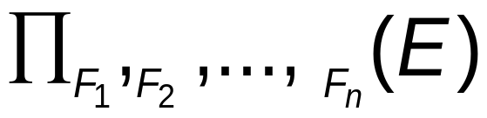
Generalized Projection
Extends the projection operation by allowing arithmetic functions to be used in the projection list
E is any relational-algebra expression
Each of F₁, F₂, …, F_{n} are arithmetic expressions involving constants and attributes in the schema of E.
Chapter2 Relational Model
Notes:
通过允许在投影列表中使用算术函数来扩展投影操作
e是任何关系代数表达式
f1、f2、…、fn中的每一个都是涉及e模式。

Slide 64
Generalized Projection
Example
Given relation
credit_info(customer_name, limit, credit_balance),
find how much more each person can spend:
∏customer_name, limit – credit_balance (credit_info)
Chapter2 Relational Model

Slide 65
Aggregate Functions
Aggregate function takes a collection of values and returns a single value as a result
avg: average value
min: minimum value
max: maximum value
sum: sum of values
count: number of values
Chapter2 Relational Model
Notes:
聚合函数接受一组值，并返回一个值作为结果
avg:平均值min:最小值max:最大值sum:值的总和count:值的数目

Slide 66
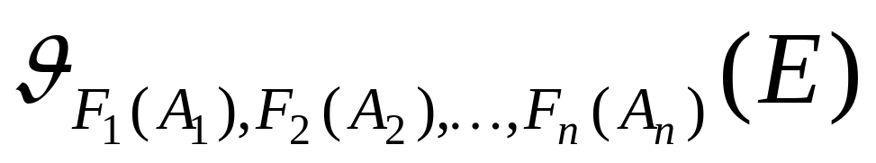
Aggregate Operations
Aggregate operation in relational algebra
Example
A
B
C
g _{sum(c)} (r)
α
α
β
β
α
β
β
β
7
7
3
10
r
sum(c )
27
Chapter2 Relational Model

Slide 67
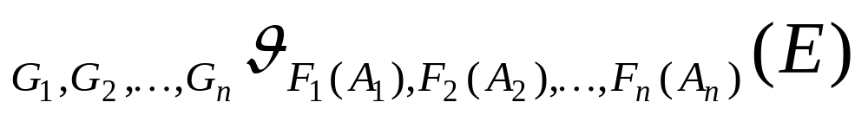
Aggregate Operations
Relation E
Grouping
G1, G2, …, Gn
F1(A1), F2(A2), …, Fn(An)
Chapter2 Relational Model

Slide 68
Example
branch_name
account_number
balance
Perryridge
Perryridge
Brighton
Brighton
Redwood
A-102
A-201
A-217
A-215
A-222
400
900
750
750
700
_{branch_name} g _{sum(balance)} (account)
branch_name
sum(balance)
Perryridge
Brighton
Redwood
1300
1500
700
Chapter2 Relational Model

Slide 69
Aggregate Operations
Cont.
Result of aggregation does not have a name
  Can use rename operation to give it a name
  For convenience, we permit renaming as part of aggregate operation
_{branch_name} g _{sum(balance)} (account)
_{branch_name} g _{sum(balance) as sum-balance} (account)
Chapter2 Relational Model

Slide 70
Outer Join
An extension of the join operation that avoids loss of information
Computes the join and then adds tuples form one relation that does not match tuples in the other relation to the result of the join
Uses null values:
  null signifies that the value is unknown or does not exist
  All comparisons involving null are (roughly speaking) false by definition.
Chapter2 Relational Model

Slide 71
Example
Relation loan
loan_number
branch_name
amount
L-170
L-230
L-260
Downtown
Redwood
Perryridge
3000
4000
1700
Relation borrower
customer_name
loan_number
Jones
Smith
Hayes
L-170
L-230
L-155
Chapter2 Relational Model

Slide 72
Example
Join
loan borrower
loan_number
branch_name
amount
customer_name
L-170
L-230
Downtown
Redwood
3000
4000
Jones
Smith
Left Outer Join
loan borrower
loan_number
branch_name
amount
customer_name
L-170
L-230
L-260
Downtown
Redwood
Perryridge
3000
4000
1700
Jones
Smith
null
Chapter2 Relational Model

Slide 73
Example
Right Outer Join
loan borrower
loan_number
branch_name
amount
customer_name
L-170
L-230
L-155
Downtown
Redwood
null
3000
4000
null
Jones
Smith
Hayes
Full Outer Join
loan borrower
loan_number
branch_name
amount
customer_name
L-170
L-230
L-260
L-155
Downtown
Redwood
Perryridge
null
3000
4000
1700
null
Jones
Smith
null
Hayes
Chapter2 Relational Model

Slide 74
Null Values
It is possible for tuples to have a null value, denoted by null, for some of their attributes
null signifies an unknown value or that a value does not exist.
The result of any arithmetic expression involving null is null
Aggregate functions simply ignore null values (as in SQL)
Chapter2 Relational Model
Notes:
对于元组的某些属性，元组可能有一个用NULL表示的空值。
空表示未知值或值不存在。
任何涉及空的算术表达式的结果都为空
聚合函数只忽略空值（如在SQL中）

Slide 75
Null Values
Cont.
For duplicate elimination and grouping, null is treated like any other value, and two nulls are are assumed to be the same
Comparisons with null values return the special truth value: unknown
Result of select predicate is treated as false if it evaluates to unknown
Chapter2 Relational Model
Notes:
对于重复消除和分组，空值被视为任何其他值，并且假定两个空值相同。
与空值的比较返回特殊的真值：未知
如果select谓词的计算结果为unknown，则将其视为false

Slide 76
Null Values
Cont.
Three-valued logic using the truth value unknown:
  OR: (unknown or true) = true,
  (unknown or false) = unknown
  (unknown or unknown) = unknown
  AND: (true and unknown) = unknown,
  (false and unknown) = false,
  (unknown and unknown) = unknown
  NOT: (not unknown) = unknown
  In SQL “P is unknown” evaluates to true if predicate P evaluates to unknown
Chapter2 Relational Model

Slide 77
Modification of the Database
The content of the database may be modified using the following operations:
  Deletion
  Insertion
  Updating
All these operations are expressed using the assignment operator
Chapter2 Relational Model
Notes:
可以使用以下操作修改数据库的内容：
删除
插入
正在更新
所有这些操作都用赋值运算符表示

Slide 78
Deletion
A delete request is expressed similarly to a query, except instead of displaying tuples to the user, the selected tuples are removed from the database.
Can delete only whole tuples; cannot delete values on only particular attributes
A deletion is expressed in relational algebra by:
r ← r – E
where r is a relation and E is a relational algebra query
Chapter2 Relational Model
Notes:
删除请求的表达方式与查询类似，除了向用户显示元组之外，所选元组将从数据库中删除。
只能删除整个元组；不能只删除特定属性上的值
删除在关系代数中表示为：
R？R–E
其中r是关系，e是关系代数查询

Slide 79
Example
Delete all account records in the Perryridge branch
account ← account – σ _{branch_name = “Perryridge”} (account )
Delete all loan records with amount in the range of 0 to 50
loan ← loan – σ _{amount ≥ 0 and amount ≤ 50} (loan)
Chapter2 Relational Model

Slide 80
Example
Delete all accounts at branches located in Needham.
r₁ ← σ _{branch_city = “Needham”} (account branch )
r₂ ← ∏ _{account_number,} _{branch_name, balance} (r₁)
r₃ ← ∏ _{customer_name, account_number} (r₂ depositor)
account ← account – r₂
depositor ← depositor – r₃
Chapter2 Relational Model

Slide 81
Insertion
To insert data into a relation, we either:
  specify a tuple to be inserted
  write a query whose result is a set of tuples to be inserted
in relational algebra, an insertion is expressed by:
r ← r ∪ E
where r is a relation and E is a relational algebra expression
The insertion of a single tuple is expressed by letting E be a constant relation containing one tuple.
Chapter2 Relational Model
Notes:
要将数据插入关系，我们可以：
指定要插入的元组
编写一个查询，其结果是一组要插入的元组
在关系代数中，插入表示为：
R E授权书
其中r是一个关系，e是一个关系代数表达式。
一个元组的插入是通过让e成为包含一个元组的常量关系来表示的。

Slide 82
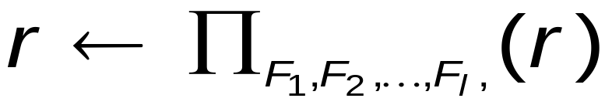
Updating
A mechanism to change a value in a tuple without charging all values in the tuple
Use the generalized projection operator to do this task
Each F_{i} is either
  the I ^{th} attribute of r, if the I ^{th} attribute is not updated, or,
  if the attribute is to be updated F_{i} is an expression, involving only constants and the attributes of r, which gives the new value for the attribute
Chapter2 Relational Model
Notes:
一种不用对元组中的所有值收费而改变元组中的值的机制。
使用广义投影运算符执行此任务
每个FI都是
r的i th属性，如果i th属性未更新，或者，
如果要更新属性，fi是一个表达式，只涉及常量和r的属性，这将为属性提供新的值。

Slide 83
Example
Pay all accounts 5 percent interest
account ← ∏ account_number, branch_name, balance * 1.05 (account)
Pay all accounts with balances over $10,000 6 percent interest and pay all others 5 percent
account ← ∏ account_number, branch_name, balance * 1.06 (σ _{BAL > 10000} (account )) ∪ ∏ account_number, branch_name, balance * 1.05 (σ_{BAL ≤ 10000} (account))
Chapter2 Relational Model

Slide 84

Conclusions
Chapter2 Relational Model

Slide 85

Questions?
Chapter2 Relational Model

Slide 86
End of Chapter 2

